Slide 1
Getting Started with Oracle ADF
(Section 1)

Slide 2
Introduction
The Enterprise Java application development has become much easier, but you may notice certain gaps in it:
The learning curve is steep for a beginner
It lacks tooling support that provides a visual and declarative development experience
Java EE specification does not cover all the generic needs
some of the challenges of enterprise application development with regard to the tools and technology:
Choice of the right tool and platform
The developer's productivity
One product and many customers
Businesses grow and so do the business users

Slide 3
Why Oracle ADF
The following is what makes Oracle ADF one of the best tools for building rich enterprise applications:
End-to-end solution
Improved developer productivity
Rich Internet Application (RIA) and Web 2.0 enablement
Technology choice
Reference architecture
Scalable architecture
Modular architecture

Slide 4
Oracle ADF architecture
Oracle ADF has a well-proven, extensible, and layered architecture, which improves the flexibility, maintainability, and scalability of an application.
As an architect, you can pick up the best fitting technology from a wide range of lists
If the use case demands, your ADF application can be easily enhanced later to use other technologies
Oracle ADF follows the Model-View-Controller (MVC) design paradigm.

Slide 5
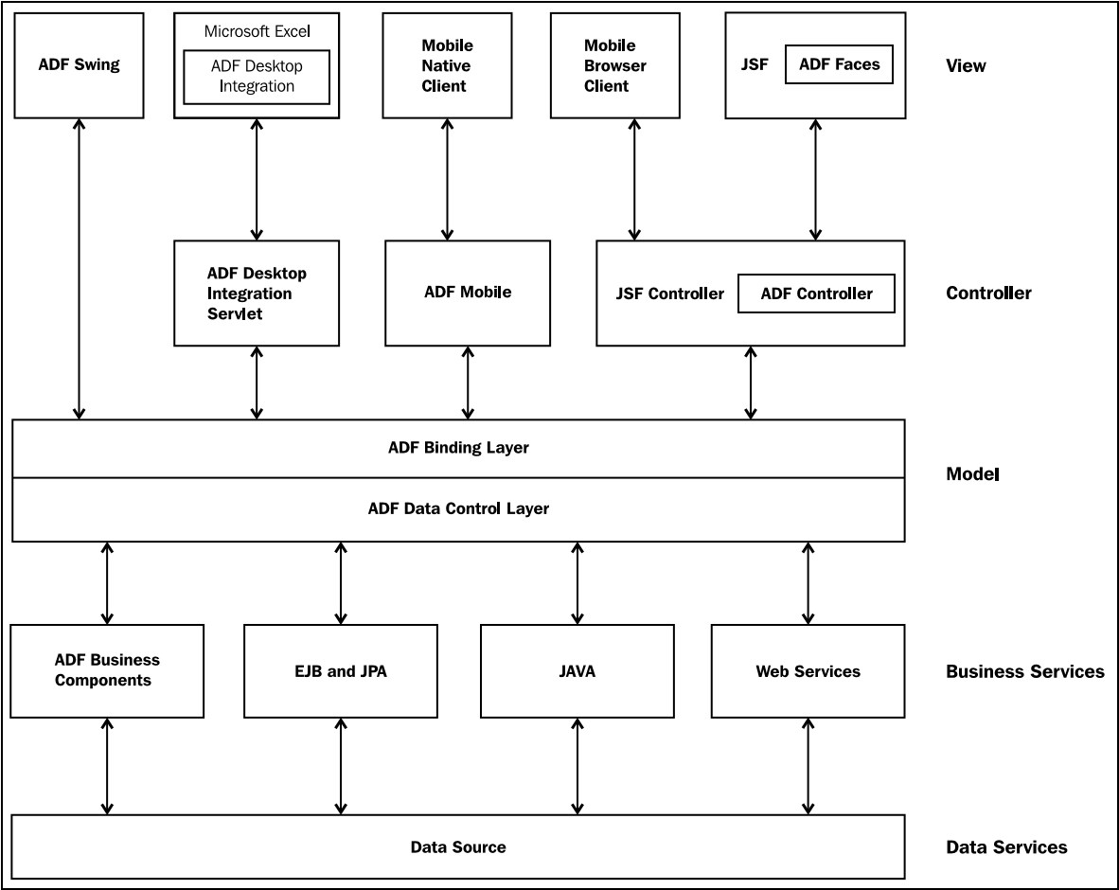
View layer
Controller layer
Model layer
Business services layer

Slide 6
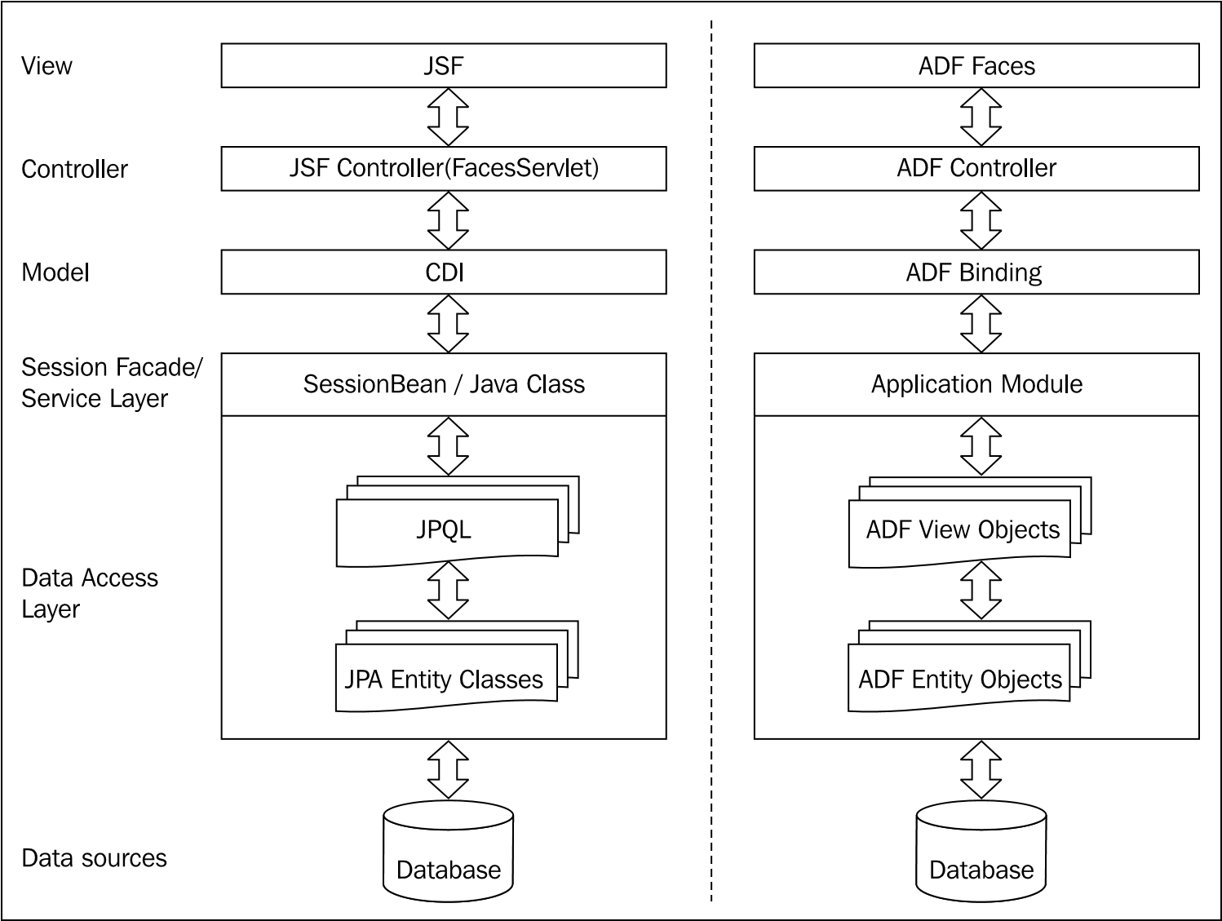
Comparing the Fusion web application technology stack to the Java EE web application

Slide 7

Developing with ADF
Setting up the development environment
Picking up the tool for development
Setting up the Software Configuration Management tool
Build tool
Team collaboration
Taking a quick tour of the JDeveloper IDE

